Slide 1
Geis Air + Sea.
Corporate presentation 2023.

Slide 2
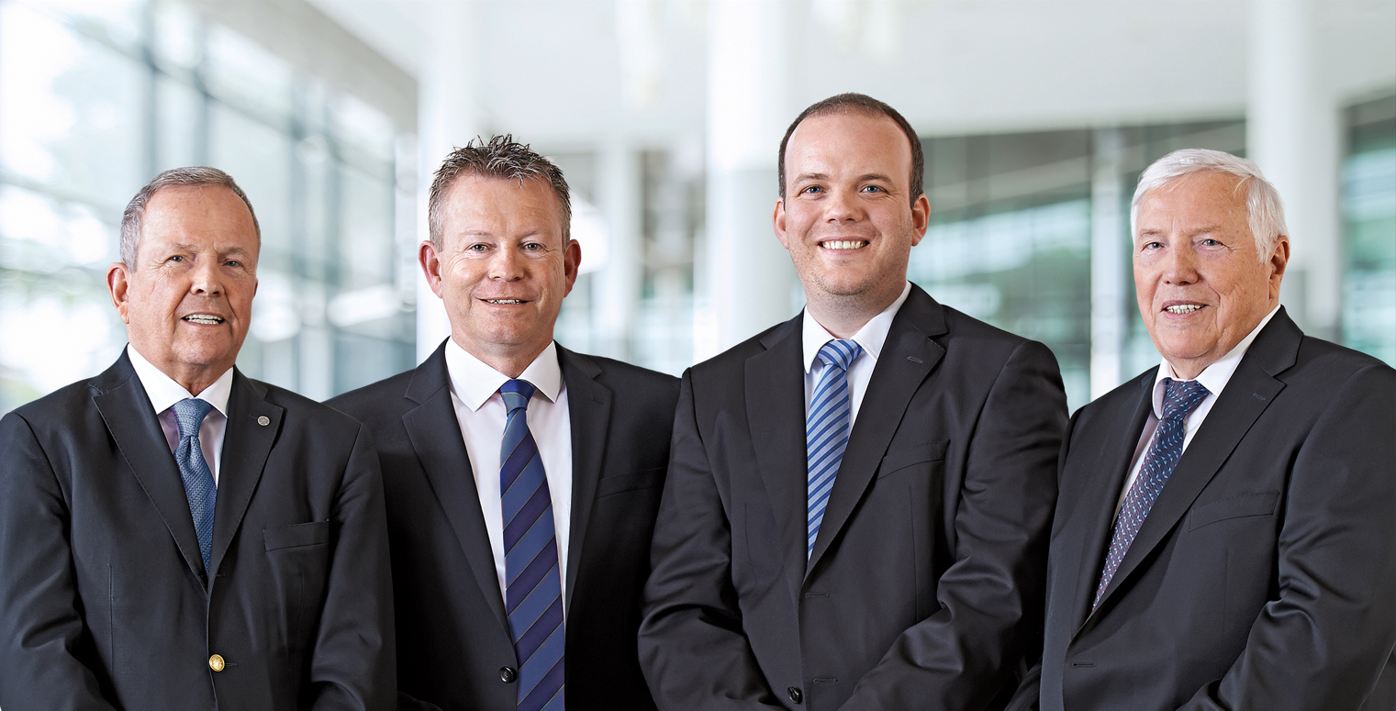
The Geis Principle.
Geis is your partner with the best overall package.
„
We attach importance to combining values such as drive and vision with concentrated logistics expertise. Geis is modern by tradition.
Hans-Georg Geis, Hans-Wolfgang Geis, Jochen Geis and Wolfgang Geis (from the left)
Our philosophy:
Satisfy customers not only in individual matters, but in all aspects.
Combining the expertise and performance of a large company with the commitment and flexibility of a medium-sized enterprise.

Slide 3
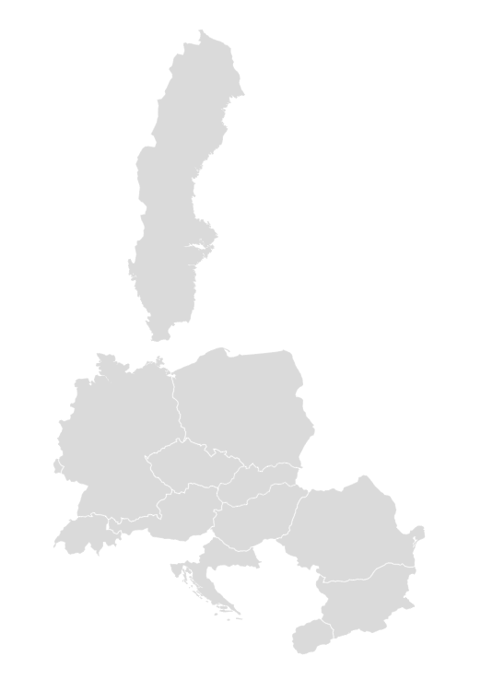
The Geis Group locations.
SWEDEN
2
Geis as logistics specialist in the centre of Europe.
POLAND
22
GERMANY
67
26
LUXEMBOURG
CZECH REPUBLIC
2
SLOVAKIA
13
20
HUNGARY
11
3
AUSTRIA
3
SWITZERLAND
ROMANIA
177
Locations in Europe
1.8 million sqm.
Logistics and handling area
CROATIA
3
2
NORTH-
MACEDONIA
BULGARIA
3

Slide 4
A big player among SMEs.
Our key figures at a glance.
2 billion Euro
Turnover
13.7 million
Transport orders
10.000 Employees, of which 337 apprentices
1,8 million sqm.
Logistics and handling area
177 Locations
13 Countries
Figures for the year, as at 31/12/2022

Slide 5
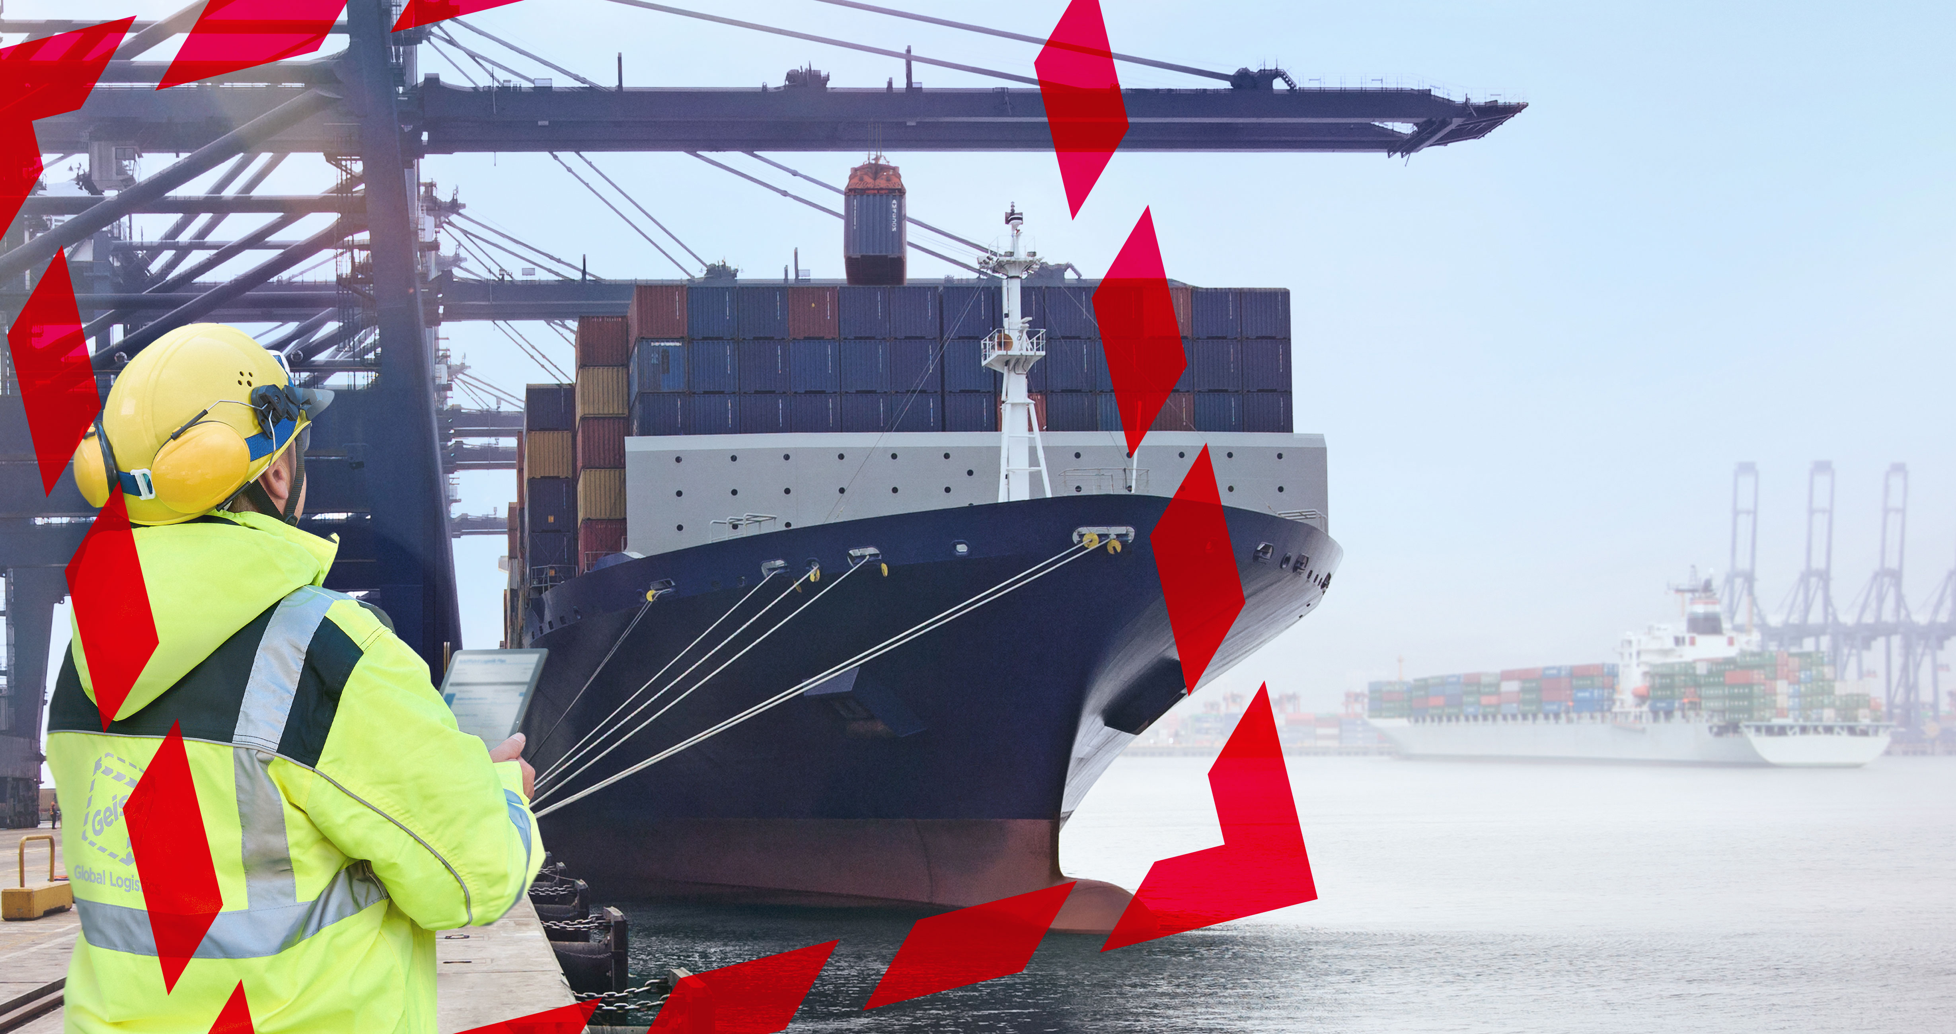
Our business areas and service offerings.
Geis Air + Sea Services.

Slide 6
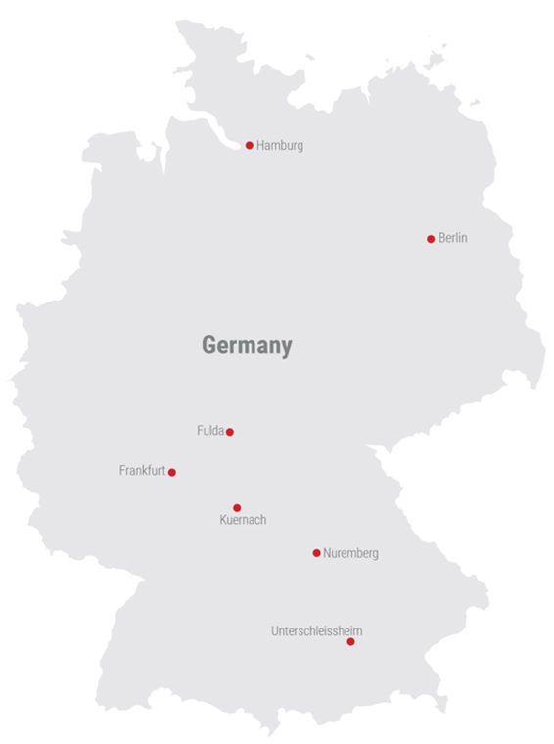
Air + Sea Services.
Data & facts - Germany.
Staff
167
Turnover
146 million EUR
Transport orders
44,000
Transported tonnage airfreight
13,000 t
Transported tonnage sea freight
36,600 TEU, LCL 235,500 cbm
Locations
7

Slide 7
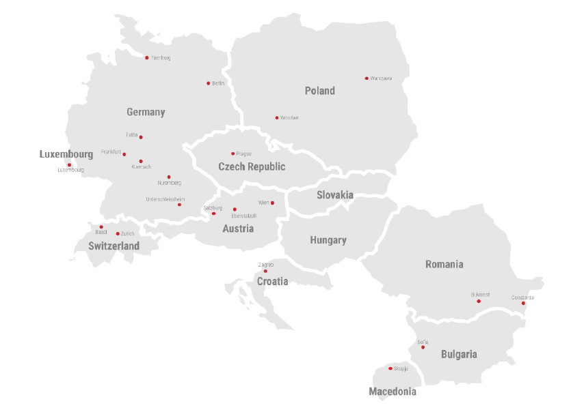
Air + Sea Services.
Data & facts - Europe.
Staff
320
Turnover
260 million EUR
Transport orders
78,000
Transported tonnage airfreight
22,500 t
Transported sea freight
57,000 TEU, LCL 270,000 cbm
Locations
23

Slide 8
Our business fields and services.
Overview of Geis Air + Sea Services.
Air Freight
Worldwide direct transports and groupage transports from/to the most important gateways
Global door-to-door service and cross-trade handling
Partial charter and full charter projects
Express shipping for time-critical consignments
Sea Freight
FCL and LCL transports from/to the main gateways
Combined transports (sea/air and air/sea) as well as implementation conventional loading
Oversized goods and special logistics requirements
Rail Transportation
Rail transports – inbound/outbound Asia
Project Logistics
Worldwide project management (turnkey projects)
IT solutions
Electronic customs clearance (AES, Dakosy) and electronic document management
EDI interfaces (IFTMIN, IFTSTA) and implementation of common industry standards
Reporting on the basis of individual KPI and creation of exceptions reports
Security scanning and compliance checks

Slide 9
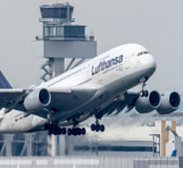
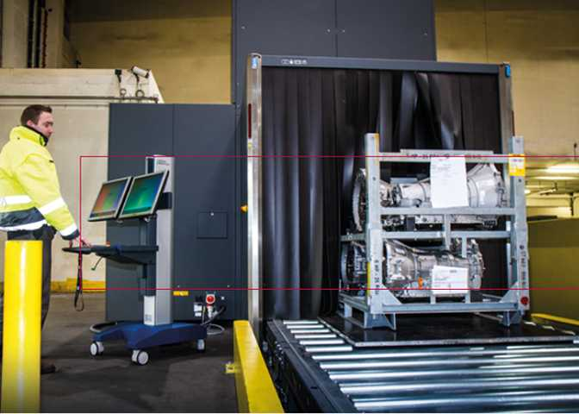
Air + Sea Services.
Overview of airfreight services.
SERVICE
DIRECT SERVICE
IATA direct transportation
Global door-to-door service
IATA dangerous goods services
Guaranteed compliance with high security standards through special services
AIR CARGO SECURITY
Use of own X-ray machines and use of X-Ray machines through our partner network
Alternative test methods such as "SPX by EDD"
Reliability-checked employees (ZÜP)
Regular trainings (Dangerous goods + Air Cargo security training courses)
Authorized Economic Operator (AEO) and Reg.B
CONSOL SERVICE
Efficient freight handling through central processing
Freight capacity through our own annual contracts
High security standards during freight handling in our warehouses
Notes:
Satz kürzen oder in Kästchen

Slide 10
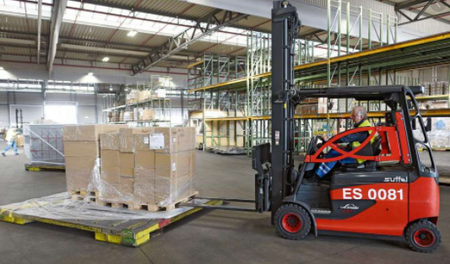
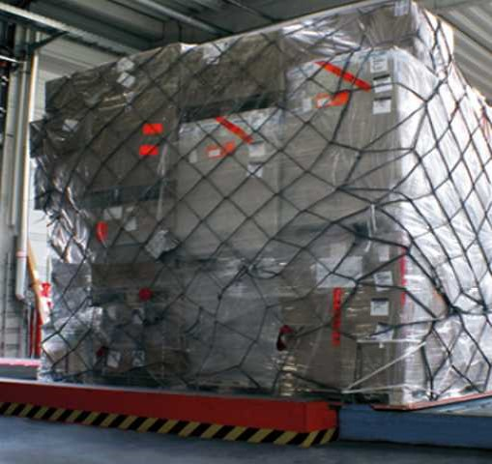
Air + Sea Services.
Overview of airfreight services.
SERVICE
IMPORT HANDLING
Customs clearance through EDI connections
Takeover shipments
Visible control of shipments (e.g. damages)
Issuing of damage reports
Final delivery
EXPORT HANDLING
Receiving shipments in our HUB’s or directly at the airlines
Visible control (e.g. damage)
Pre-check of DG shipments by trained and authorized staff
Export customs clearance / export declaration if needed
Consolidation of shipments
Build up PSA’s and ULD’s by our own staff
Freight transfer to the airline or airline GHA
Notes:
Satz kürzen oder in Kästchen

Slide 11
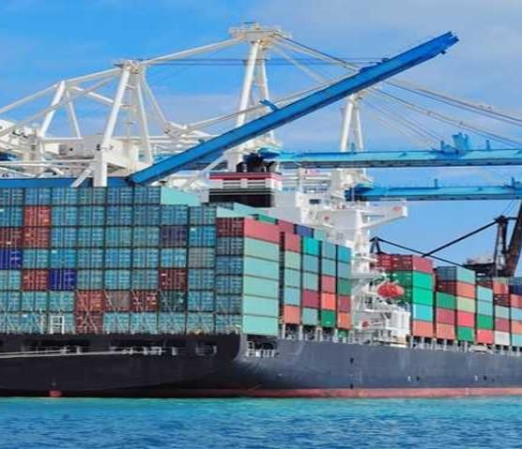
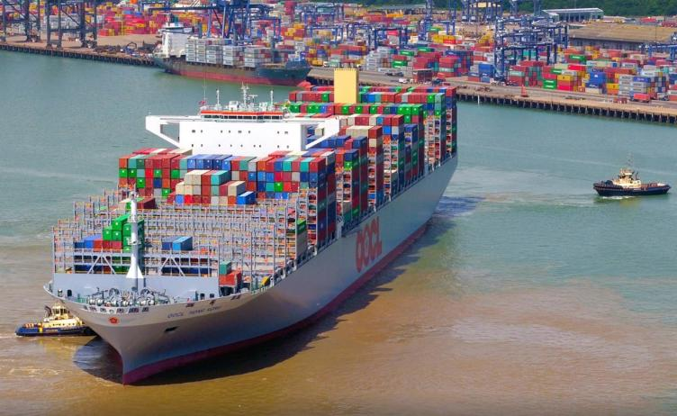
Air + Sea Services.
Overview of sea freight services.
SERVICE
DIRECT SERVICE
Long-term contracts with fixed allocations
FCL services
Special equipment e.g. RoRo
IN GENERAL
Own allocations with different freight alliances
NVOCC
B2B and B2C
Worldwide cross-trade
Intermodal transport
Pre- and On-forwarding services through our own European network
Handling of special equipment e.g. reefers, DGR
Packaging and consolidation in our European warehouses
Own bonded logistics facilities
CONSOL SERVICE
Own consol container (LCL)
Fixed allocations with regular departures
Buyers Consolidation
Notes:
Satz kürzen oder in Kästchen

Slide 12
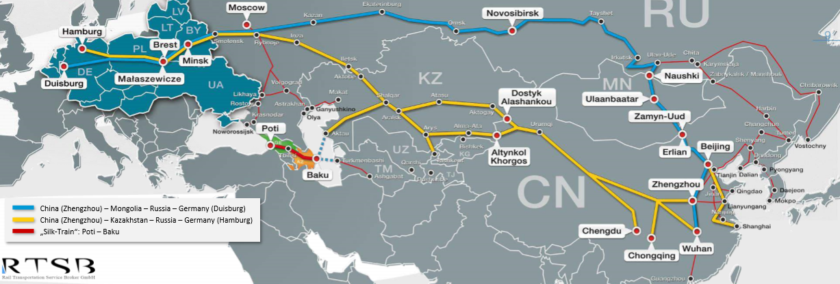
Air + Sea Services.
International railway services.
North Corridor (Trans Siberian Route), 12.900 km
Chinese Hub: Suzhou / Shilong / Ganzhou / Changchun / Shenyang / Wuhan
Routing: Northeast-China – Siberia – West Russia – Belarus– Poland – Germany (Hamburg, Duisburg)
South Corridor (New Silk Road), 10.320 km
Chinese Hubs: Chengdu / Zhengzhou / Wuhan / Yiwu / Hefei / Xian / Chongqing / Xiamen
Routing: China – Kazakhstan – West Russia – Belarus – Poland – Germany (Hamburg, Duisburg)

Slide 13
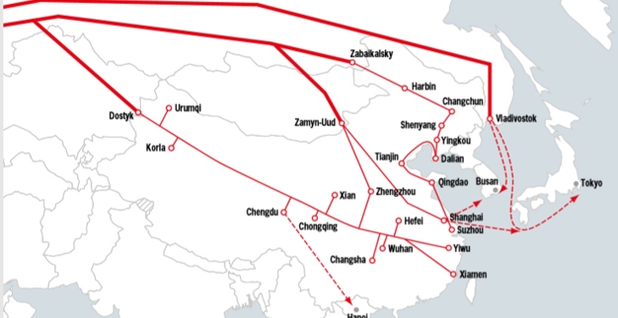
Air + Sea Services.
Overview of railway services.
SERVICE
IN GENERAL
FCL and LCL
Fixed allocations with regular departures
Buyers consol service
DG transportation
Local customs clearance
Transport insurance
High security standards at terminals and along the routes
Own container tracking through GPS tracker
LC shipments
WEEKLY DEPARTURES (DOMESTIC AND INTRNATIONAL)
e.g. via the routes Zhengzhou, Chengdu, Xi‘an, Chongqing and many more
CAPACITY
41 to 53 x 40 containers per train
Notes:
Satz kürzen oder in Kästchen

Slide 14
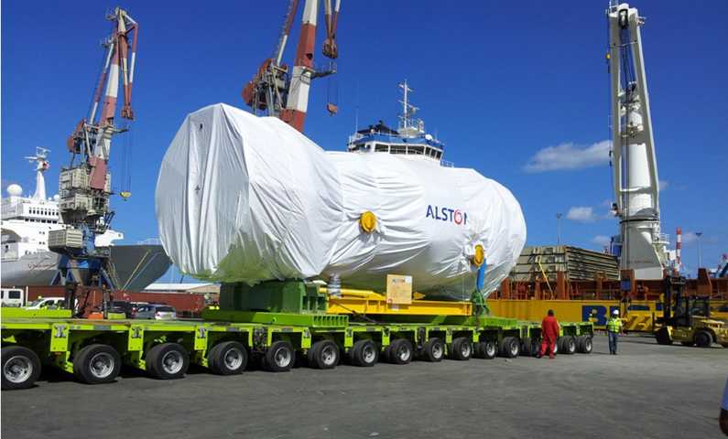
Air + Sea Services.
Project logistics by Geis project logistics.

Slide 15
Air + Sea Services.
Project logistics by Geis project logistics.
Geis is an expert in international project logistics by all means of transportation
SERVICE
Worldwide projects
Full/part charter projects
Complex heavy-lift loads and over-dimensional project cargo
Transport concepts for entire industrial plants
Transport engineering (method statements, risk analysis, installation planning)
Customized solutions

Slide 16
Air + Sea Services.
Overview of value added services.
CUSTOMS CLEARANCE AND SECURITY CHECKS
Security scans and compliance checks
REPORTING
Weekly or monthly activity reports
ORDER MANAGEMENT / DOCUMENT MANAGEMENT
Order management along the entire supply chain (end-to-end service)
Electronic import and export processing through interfaces to all common ones
Customs clearance systems (ATLAS and AES)
Reporting on specific key figures (KPIs)
Electronic documentation system
Purchase Order Management (POM) system

Slide 17
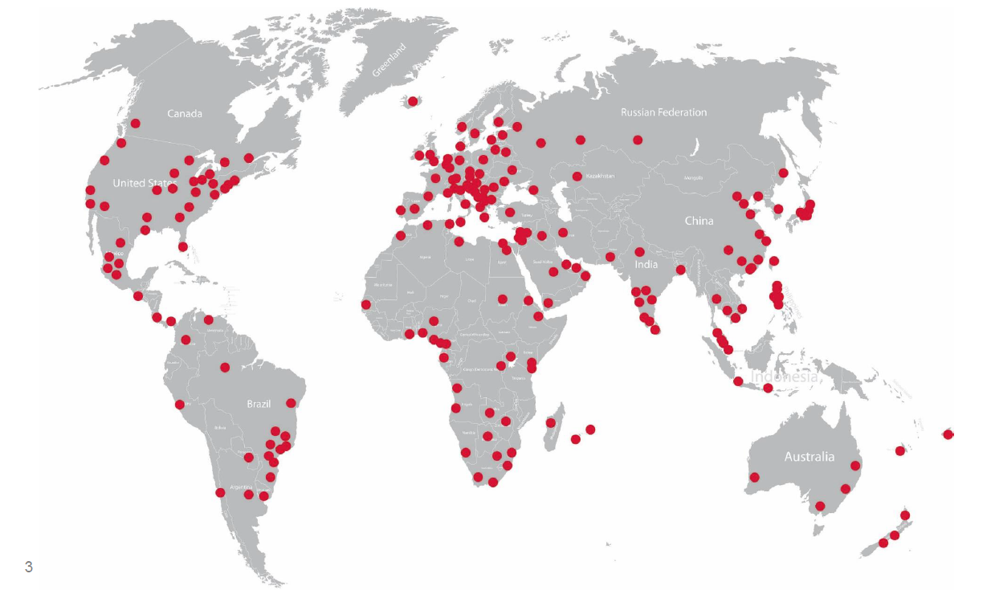
Air + Sea Services.
Worldwide on site with proven partners.
Notes:
Road:

Slide 18
Sustainability in the Geis Group.
Our strategy for climate neutrality.
„
Focus areas & goals for sustainable development:
Through our sustainable "Mission Zero" programme we aim to become climate-neutral by 2040.
Ecology:
Environmentally-friendly transports, CO₂-neutral logistics properties, resource efficiency
Social:
Talent acquisition + retention, occupational safety + health protection, diversity + equal opportunities
Economy:
Innovation + digitalisation, quality + reliability, suppliers + compliance,
sustainable business
Hans-Georg Geis, Hans-Wolfgang Geis, Jochen Geis and Wolfgang Geis
Climate-neutral products
Renewable energies and alternative drive systems reduce our CO₂ emissions
Climate-neutral handling of logistics services through our "Geis Carbon Neutral" product

Slide 19
Sustainability in the Geis Group.
Roadmap to climate neutrality by 2040.
-65%
-100%
Scope 1 + 2
2022
2023
2024
2025
2026
2027
2028
2029
2030
2040

Slide 20
Market leaders trust Geis.
Working for the best - always performing at our best.
Mercedes-Benz Group AG
The image shows a selection of our customers.

Slide 21
Solid partnerships in many industries.
Different branches, individual solutions.
Aerospace
Evelop Airlines
Global Helicopter Services
Lufthansa Technik Logistik Services
Proptech Aero
Tiger Aviation
SR Technics
Consumer Goods
babymarkt.de
BSH
CUBE Bikes
Coca-Cola
dm-drogerie markt
Faber-Castell
Gardena
Genius
Ghost Bikes
Grundig
Husqvarna
Intersport
Jeld Wen
Kneipp
MediaMarktSaturn Musikhaus Thomann Nespoli GmbH
Obi
Okay
Playmobil
Puma
Powerslide Rewe
Samsung
Simba Dickie Group Stürmer Maschinen
TianDe
Uvex
Witt Weiden
yfood
HealthCare
Eckert&Ziegler
Fresenius Medical Care
GE Healthcare
Mölnlycke health care
Qiagen
Scherf-Präzision Europa
Siemens Healthineers
Industrial Goods
ABB
Diebold Nixdorf ebm-papst Mulfingen
Framatome
Gardner Denver
K.D. Feddersen Klaus Faber AG
Krones
Leoni
Moog
Schaeffler
Siemens
SKF
Vossloh
Automotive
Bosch
Daimler Goodyear Dunlop
Grammer
Knorr-Bremse Magna Mirrors
MAN
MöllerTech Thüringen
Nokian Tyres
Rehau
Siemens
Volkswagen
ZF Friedrichshafen
HighTech
Atos
Rittal
Semikron
Siemens
Sunpower
Taiyo Yuden
Unify
Würth
Others branches
Altana
Antalis Verpackungen
BayWa
Drykorn
Kräuter Mix
Knauf PFT
Kunert s.Oliver UPONOR Vereinigte Papierwarenfabriken

Slide 22
Consistently at the forefront.
The awards for our performance speak for themselves.
Outstanding corporate quality, customer focus and employee loyalty satisfaction: Award winner in the "Business-oriented service providers" category
TOP 10
Study
"Excellent at fulfilling customer requirements 2023"
Entrepreneur
of the year 2012
Unternehmer des Jahres 2012
Strong growth in headcount and sales: 6x BAYERNS BEST 50 award-winner
Germany's shippers trust Geis: 7th in the Verkehrsrundschau image ranking in the area of industrial contract logistics
Outstanding with regard to training: 1st (out of 50) among training companies in the field of forwarding, transport and logistics
Excellent with regard to punctuality and quality: Geis ranks 1 to 3 in the IDS Quality Ranking 2022

Slide 23
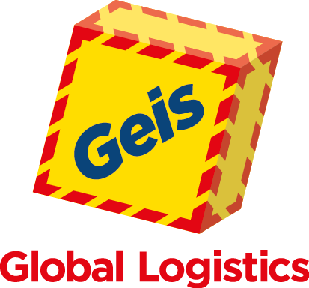
The Geis brand.
Values and competencies at a glance.
CORE VALUES
CORE COMPETENCES
Vision
Matching offering
Togetherness
Pro-active approach
Drive
IT performance strength
Dynamics
Concentrated know-how
Consistency
Solid financing
Excellence
Personal commitment
The logistics partner with the best overall package.

Slide 24
Directory Air + Sea offices.
We offer you logistics from a single source.
CONTACT DETAILS - GERMANY
BAD NEUSTADT Geis Air + Sea GmbH
Rudolf-Diesel-Ring 24
97616 Bad Neustadt
Tel: +49 (0) 911 – 669441 0
FULDA Geis Air + Sea GmbH
Heinrichstraße 79
36037 Fulda
Tel: +49 (0) 661 – 8300 100
Branch Manager: Florian Kollmann
FRANKFURT Geis Air + Sea GmbH
CargoCity Süd, Geb. 556 E
60549 Frankfurt
Tel: +49 (0) 69 – 697678 0
NUREMBERG Geis Air + Sea GmbH
Marienbergstrasse 82
90411 Nuremberg
Tel: +49 (0) 911 – 669441 0
Branch Manager: Mehmet Danisan
BERLIN Geis Air + Sea GmbH
Paradiesstraße 206b
12526 Berlin
Tel: +49 (0) 30 – 308892 0
Branch Manager: Petra Grötzsch
MUNICH Geis Air + Sea GmbH
Siemensstrasse 8
85716 Unterschleissheim
Tel: +49 (0) 911 – 669441 0
KUERNACH Geis Air + Sea GmbH
Industriepark 7-11
97273 Kuernach
Tel: +49 (0) 9367 – 987 100
Branch Manager: Henry Portisch
HAMBURG Geis Air + Sea GmbH
Mattentwiete 8
20457 Hamburg
Tel: +49 (0) 40 – 298134 0
Branch Manager: Felix Lund
HAMBURG – AERO Geis Air + Sea GmbH
Mattentwiete 8
20457 Hamburg
Fon: +49 (0) 40 – 298134 0
Branch Manager: Joerg Hansen
E-Mail: info.air-sea@geis-group.de Web: www.geis.group.com
Notes:
Satz kürzen oder in Kästchen

Slide 25
Directory Air + Sea offices.
We offer you logistics from a single source.
CONTACT DETAILS - EUROPE
LUXEMBOURG
Geis Cargo International
Luxembourg GmbH
Cargo Centre Luxair, West Geb. S, O.326-328
1360 Luxembourg
Tel.: +352 3486169801
E-Mail: info.lux@geis-group.de
Web: www.geis-group.com
POLAND Geis Cargo International
Poland Sp. z o.o.
Poleczki 33
02-822 Warsaw
Tel.: +48 22 653 90 00
Branch Manager:
Agnieszka Kottal
E-Mail: info@geis-group.pl
Web: www.geis-group.pl
POLAND Geis Cargo International
Poland Sp. Z o.o.
Żelazna 59/6.8
00-848 Warsaw
Tel.: +48 22 653 90 00
Branch Manager:
Agnieszka Kottal
E-Mail: info@geis-group.pl
Web: www.geis-group.pl
POLAND Geis Cargo International
Poland Sp. z o.o.
SBC Centre, Szybowcowa 31
54-130 Breslau
Tel.: +48 71 358 11 75
Branch Manager:
Izabela Machnikowska
E-Mail: sales@geis-group.pl
Web: www.geis-group.pl
CZECH
Geis CZ Air + Sea s.r.o.
Aviatická 1048/12
168 00 Prague - Ruzyna
Tel.: +420 951 211 701
Branch Manager: Martin Tokic
E-Mail: air.sea@geis.cz
Web: www.geis.cz
SWITZERLAND General Transport AG
Zurich Airport
Geb. LUX, Saegereistraße 29
8152 - Glattbrugg
Tel.: +41 44 824 54 00
Branch Manager:
Thomas Benz
E-Mail: info@general-transport.com
Web: www.general-transport.com
SWITZERLAND
General Transport AG
Freight Bldg
CH 4030 Basel Airport
Tel.: +41 61 325 27 27
Branch Manager: Felix Marbet
E-Mail: info@generaltransport.com
Web: www.general-transport.com
SWITZERLAND
General Transport AG
St. Alban-Ring 254
4020 Basel
Tel.: +41 61 31925 25
Branch Manager: Alan Zedi
E-Mail: info@general-transport.com
Web: www.general-transport.com
Notes:
Satz kürzen oder in Kästchen

