Slide 1
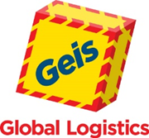
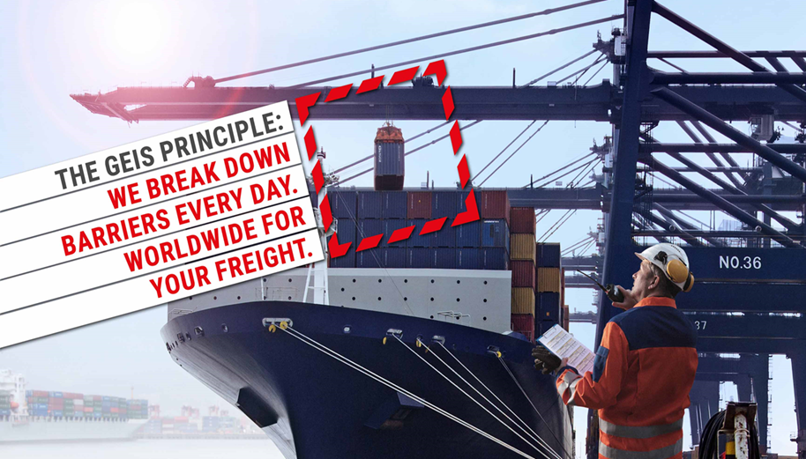
Anweisungen
Geis Air + Sea:
Your partner with the best complete package.
Business fields and service portfolio
IATA direct transportations
Own consolidation products
Part and full charter projects
FCL and LCL transportation
Combined transportation (Sea/Air, Air/Sea)
Railway services from and to Asia
Tailored Aerospace and time critical transport solutions
Pre- and on-forwarding services
Worldwide tailormade project management
Key facts
320 employees for Air + Sea in Europe
23 European operative Air + Sea locations
Industry verticals: aerospace, textile, consumer goods, pharma, automotive, projects
More than 70 years experience in the logistics market, global network and dedicated partners
Certified according to ISO 9001/14001/ 27001, AEO, Reg-B and award-winning performances
Geis Air + Sea is part of the family-owned Geis Group with a solid financial base
Value added services
Import/Export customs clearance (Sea/Air)
Security and x-ray checks with own staff and machines
DGR/IMO handling
Own container (de-) stuffing possibilities
Customized reports and KPI statistics
Individual EDI and XML interfaces
Track + Trace solutions
Purchase Order Management - System
Individual logistics consulting for our customers
Personal one-face to the customer principal
Value proposition
75 own logistics warehouses for contract logistics and multiuser warehouses with 910,000 sqm. in Europe
Full coverage of LTL/FTL/groupage cargo in Europe with 125 own locations and hubs including 192,000 sqm. of own handling area
Top logistics provider in Germany and Central and South-Eastern Europe
Own packaging company within the Geis Group
Motivated and flexible employees due to family-orientated corporate culture

