Slide 1
Geis Air + Sea services.
Aerospace Logistics.

Slide 2
Agenda.
Airfreight portfolio
Advantages of Geis Air + Sea
1
5
Aerospace / Time critical portfolio
2
Time critical process flow
3
EDI connection
4

Slide 3
Airfreight portfolio.
Regular and special airfreight services.
REGULAR AIRFREIGHT, DIRECT SERVICES
TIME CRITICAL AIRFREIGHT
Worldwide IATA direct services
Global door-to-door services
IATA dangerous goods services
Guaranteed compliance with high security standards through special services
AOG
NFO
OBC
Air (part-) charter
REGULAR AIRFREIGHT, CONSOL SERVICES
PROJECT LOGISTICS (AIR,SEA,RAIL,TRUCK)
Efficient freight handling through central processing
Freight capacity through our own annual contracts
High security standards during freight handling in our warehouses
Worldwide turnkey projects
Full/part charter projects
Solutions for complex heavy-lift loads and over-dimensional project cargo
Transport concepts for entire industrial plants
Transport engineering (method statements, risk analysis, installation planning)
Individual solution

Slide 4
Agenda.
Airfreight portfolio
Advantages of Geis Air + Sea
1
5
Aerospace / Time critical portfolio
2
Time critical process flow
3
EDI connection
4

Slide 5
Aerospace / Time critical service portfolio.
In general.
SPEED
COMMUNICATION
RELIABLE NETWORK
Late pickup and early delivery through short handling times
Next day delivery, even to remote regions through interconnected transport solutions
Pro-active status information
Pre-defined alternative processes in case of unexpected disruptions
EDI link for data communication purposes
Routine reporting
24/7 operations
Guaranteed shipping within time-critical partner network worldwide
Point-to-point network without detours via large hubs including pickup, delivery, and customs clearance
TAILORED PROCESS
POINT-TO-POINT
EXPERTISE
Transportation and routing based on customer needs
24/7 availability for the acceptance and booking of all types of time-critical shipping orders
No consolidation
Immediate, direct, customized
Priority boarding
Highly-skilled and motivated team
Extensive know-how and expertise
Available 24/7/365
Control Tower

Slide 6
Time critical service portfolio.
Time critical products.
AOG Services
NFO
Services
OBS Services
Airfreight Charter
Notes:
Die Vorlage muss ich noch in die GEIS Farben anpassen

Slide 7
Aircraft On Ground (AOG) Service.
Spare parts are placed on first available flight.
AOG – Aircraft on Ground services ensures that time & financially sensitive AOG parts are placed on first available flight and arrive without delay
SERVICE
AOG team available 24/7
Upgrade shipments from routine to AOG
Selection of best routing according to the on dock date
Secure appropriate space with the selected airline or carrier
Use of first class carriers
Services adapted to the urgency
Direct flight priority and priority boarding
Use of block space agreements
Continuous improvement plan, with performance review
Simplified transfer procedure
Compliant with local regulations

Slide 8
Next flight out (NFO) service.
The fastest way to get freight moved.
SERVICE
NFO is faster than any other freight forwarding services
NFO gives the advantages of high speed, but without the need for an On Board Courier or Air Charter
NFO service guarantees that the routing with the fastest arrival will be chosen
Offering same-day shipments to and from many locations
Each shipment is individually monitored to ensure that the shipment will be delivered as quickly as possible
PROCESS
Locating of nearest airports at origin and destination
Identifying the optimal flights departing and arriving at these airports
Immediate collection at supplier side
Tendering freight and straight delivery to the appointed carrier
Upon flight arrival, retrieving of shipment and immediate delivery to the consignee

Slide 9
On board courier (OBC) service.
Maximum speed in combination with highest security.
If a personal delivery is required for an extremely urgent and highly sensitive shipment that requires a personal surveillance we are organizing a “hand carry” and accompany the cargo on board the aircraft and to the final hand over point
SERVICE
Global coverage
Specially-trained couriers for the highest quality standards
All couriers equipped with visas required worldwide
Personal pick-up and delivery
Own tracking system for OBC shipments
Handling of all organizational and regulatory procedures (e.g. fully compliant to customs regulations and immigration requirements, etc.)

Slide 10
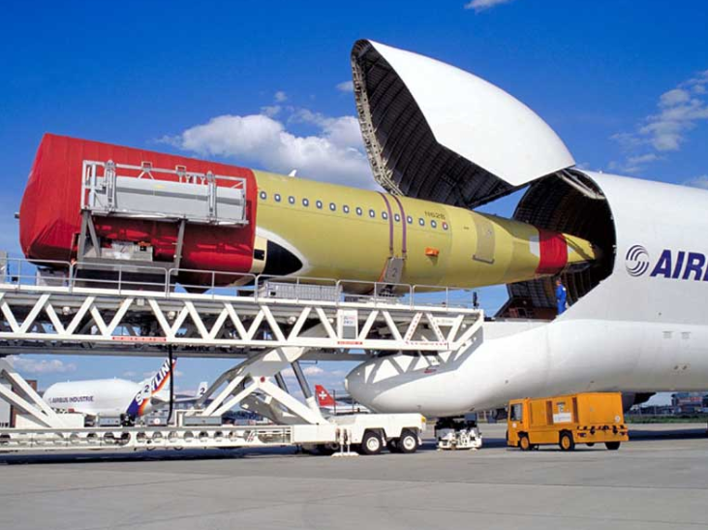
Air freight charter.
Tailor-made charter solutions for individual needs.
SERVICE
We analyze the best route including airport of origin and destination
Selection of the right and most economical cargo aircraft for our customer requirements
Organization of part-charter for ad hoc, peak season and project cargo
Notes:
Satz kürzen oder in Kästchen

Slide 11
Agenda.
Airfreight portfolio
Advantages of Geis Air + Sea
1
5
Aerospace / Time critical portfolio
2
Time critical process flow
3
EDI connection
4

Slide 12
Time critical.
24/7 process flow..
Transfer to cargo section
Arrival at cargo section
Request for transportation by client
Handover to OBC
Arrival at passenger terminal
GAS acknowledge receipt within 15 minutes 24/7
Screening
Evaluation of required Service Level
Customs process
Decision
Customs inspection
yes
Opening of box
Customs inspection finished
AF
NFO
OBC
Charter
no
OBC boarding
Delivery to ground handling
Booking with airlines
Ticketing
Booking
Shipment in hand of carrier
Uplift of shipment on booked flight
Arrival of flight at final destination
Shipment and documentation ready for pick up / transfer

Slide 13
Agenda.
Airfreight portfolio
Advantages of Geis Air + Sea
1
5
Aerospace / Time critical portfolio
2
Time critical process flow
3
EDI connection
4

Slide 14
EDI Connection.
Data exchange and track & trace.
SERVICE
ONLINE DATA EXCHANGE
Online data exchange according to industry standard.
Data transparency due to real time tracking
Monthly milestone reporting
Creation of exceptions reports
TRACK & TRACE
Seamless track & trace via internet and customized to individual
requests of our customers
Web-based visibility of shipment order in real-time
Pro-active information in case of irregularities
In-time information exchange with our customers and partners
Notes:
Satz kürzen oder in Kästchen

Slide 15
Agenda.
Airfreight portfolio
Advantages of Geis Air + Sea
1
5
Aerospace / Time critical portfolio
2
Time critical process flow
3
EDI connection
4

Slide 16
Advantages oft Geis Air + Sea services.
Time critical services.
Air + Sea Services
Dedicated time critical specialists and competence centers around the world with global coverage and local expertise
Strategic time critical desks in Hamburg offering worldwide 24/7 coverage including Control Tower set up with single point of contact and billing
Ability to deliver tailor-made and innovative solutions to our customers and exceed expectations
Time definite multimodal transport services for highly specialized, time critical door-to-door delivery
More than 30 years of experience in the time critical vertical market

Slide 17
Directory Air + Sea offices.
We offer you logistics from a single source.
Joerg Hansen
Global Head of Partner Network and Aerospace / Time Critical
Tel: +49 (0) 40 – 298134 200
Mob: +49 (0) 171 – 6993453
Mail: joerg.hansen@geis-group.de
E-Mail: aerospace@geis-group.de
Web: www.geis.group.com
24/7: +49 (0) 40 298 134 204
Catrin Beckmann
Tel: +49 (0) 40 298 134 201
Mob: +49 (0) 151 151 93894
Mail: catrin.Beckmann@geis-group.de
Nicolas Lenck Tel: +49 (0) 40 298 134 202
Mob: +49 (0) 170 1268 498
Mail: nicolas.Lenck@geis-group.de
Swantje Hansen Tel: +49 (0) 40 298 134 205 MOB: +49 (0) 175 1670 727
Mail: swantje.hansen@geis-group.de
Finn Marweg Tel: +49 (0) 40 298 134 204
Mob: +49 (0) 160 438 9314
Mail: finn.marweg@geis-group.de
Phillip Bern Tel: +49 (0) 40 298 134 206
MOB: +49 (0) 151 616 369 39
Mail: phillip.bern@geis-group.de
Michel Vogel Tel: +49 (0) 40 298 134 207
MOB: +49 (0) -
Mail: michel.vogel@geis-group.de
Kjell Hansen Tel: +49 (0) 40 298 134 209
MOB: +49 (0) -
Mail: kjell.hansen@geis-group.de
Notes:
Satz kürzen oder in Kästchen

